Slide 1
Integrated 5-Year BS/MS Program
The Five-Year BS/MS Integrated Program enables highly motivated students with strong academic records to earn a Bachelor of Science in Computer Science and a Master of Science (MS) in either Computer Science, Information Studies or Computational Science, Engineering and Mathematics (CSEM) within a five-year period. The integrated program prepares students for competitive Ph.D. programs and provides strong leadership skills and technical depth to students entering professional positions.
Talented, high achieving juniors may apply to the 5-Year Integrated Program. The BS CS Option IV degree requires a total of 120 hours. The MS degree associated with this program requires a total of 30 hours. Combined, the degrees total 150 hours, spread out over five years. Students may only be admitted for fall semesters. Applications are open only to current, degree-seeking computer science majors at the University of Texas at Austin.

Slide 2
Integrated 5-Year BS/MS Program
Why Consider the Integrated 5-Year BS/MS?
Employers want and reward:
Smart students
Students with advanced skills/experience
Well rounded students
Students with areas of specialization/interest
Potential rewards for MS over BS:
Better pay ($10k – $15k more starting and higher salary potential)
More flexibility
Travel opportunities
Interesting projects
Better career opportunities in general

Slide 3
Integrated 5-Year BS/MS Program
Application Requirements
Apply in spring of junior year. Applications are due by May 1st.
Minimum 3.0 Overall UT GPA (3.5 or above is recommended to be competitive)
Minimum 3.3 CS GPA (Required)
12hrs or less heading into fall semester of senior year (up to 18 allowed, however this is NOT recommended)
Completion of all core courses BEFORE entering stage one: 312, 313K/313H or 311/311H, 314/314H, 429/429H, 439/439H and C S 331/331H (C+ or better in all core courses is recommended)

Slide 4
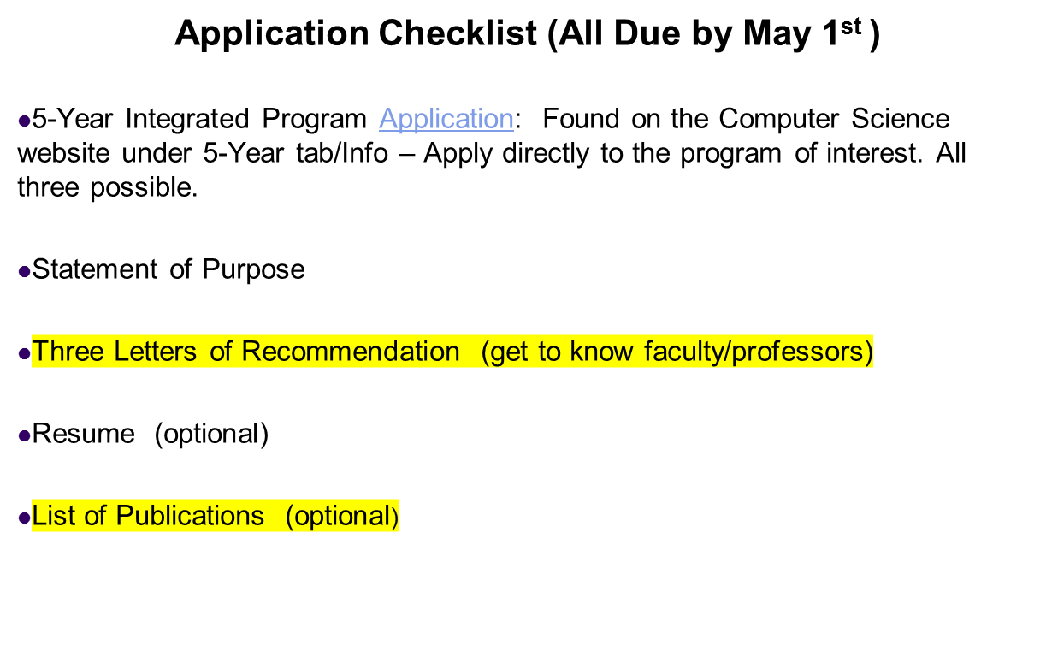
Integrated 5-Year BS/MS Program

Slide 5
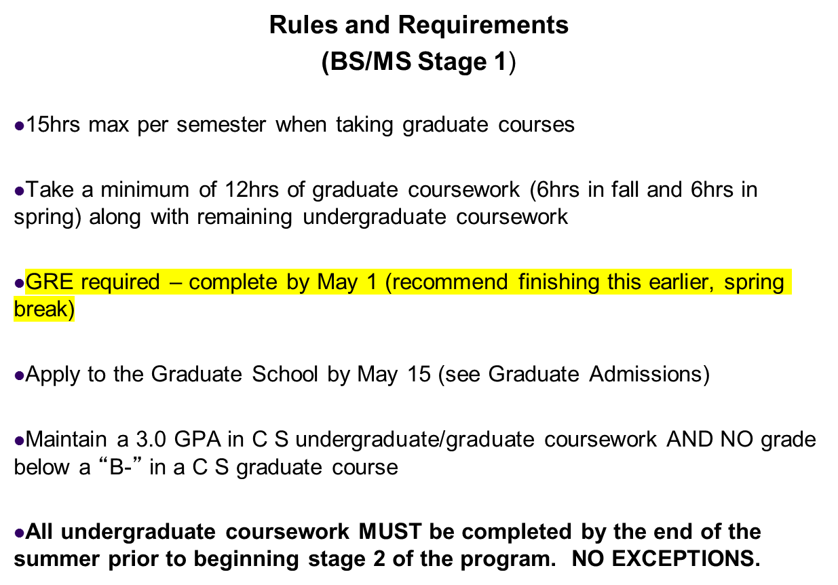
Integrated 5-Year BS/MS Program

Slide 6
Integrated 5-Year BS/MS Program:
MS in Computer Science
(Stage 2 / 5th Year)
Requirements
30hrs total (12hrs taken in Stage 1)
9hrs of Diversity Coursework (1 Course From Each Area: Theory, Systems, Applications)
(Best to take at least 2 of 3 courses in first year/stage 1 of program)
15hrs of Computer Science Coursework in Area of Interest
6hrs of Minor Coursework Outside of C S
(approved by Graduate Advisor)
Must maintain at least a 3.0 GPA in all graduate coursework to obtain degree
Bachelor’s of Science in Computer Science and Master’s of Science in Computer Science will be awarded simultaneously at the end of the 5th year.

Slide 7
Integrated 5-Year BS/MS Program
Traditional BS in Computer Science
VS
5-Year BS/MS Program
120 BS Hours (+ 30 MS hours) vs. 127 BS Hours
Be Aware that no class can count for both degrees
Awarded two degrees within a 5 year period simultaneously

